Slide 1
ADVANCED SKIN DISEASES DETECTION.
Team 5

Slide 2
ABOUT THE PROJECT

Slide 3
INTRODUCTION
The Advanced Skin Diseases System is a web application developed using Python Django, designed to assist users in identifying common skin diseases through Image Processing and Machine Learning.
The application not only provides the names of the skin diseases and information on its symptoms, but also incorporates Computer Vision (CV) techniques to process uploaded skin images.

Slide 4
Using defect detection algorithms, the system analyzes areas of concern such as rashes, pimples, or lesions. These defects are analyzed, and the system provides an accurate assessment of the condition.
Moreover, the system utilizes Machine Learning models trained on datasets of skin images to generate predictions and estimate the accuracy of its diagnosis, helping users make more informed decisions about their skin and skincare routines.

Slide 5
PROJECT OVERVIEW AS CUSTOMER FEATURE
Create: A new user account to access the application.
Login: With your username and password.
Input page: User can upload their photos.
View page: User can view their uploaded images

Slide 6
MILESTONE
The system allows users to register, log in, and verify email addresses, with password reset functionality and security measures to protect user data.
We learn about the OpenCV and using this we understand how to process the images, in this we convert real image into gray scale, inverted, blur or more.
1
2

Slide 7
MILESTONE
We implemented the UI to read an image from user, process that image with OpenCV to calculate the dimensions of the skin disease area in UI back
We prepared the dataset for training the model to generate approximate accurate values.
3
4

Slide 8

HOME PAGE AND LOGIN PAGE SCREENSHOTS

Slide 9
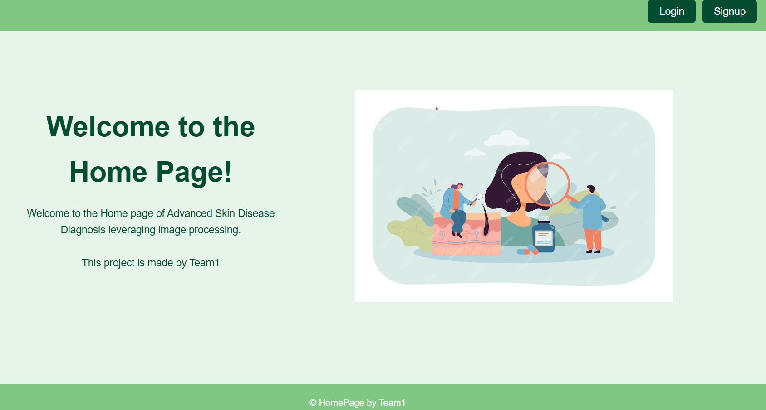
HOME PAGE:
Redirects to Signup page
Redirects to Login Page

Slide 10
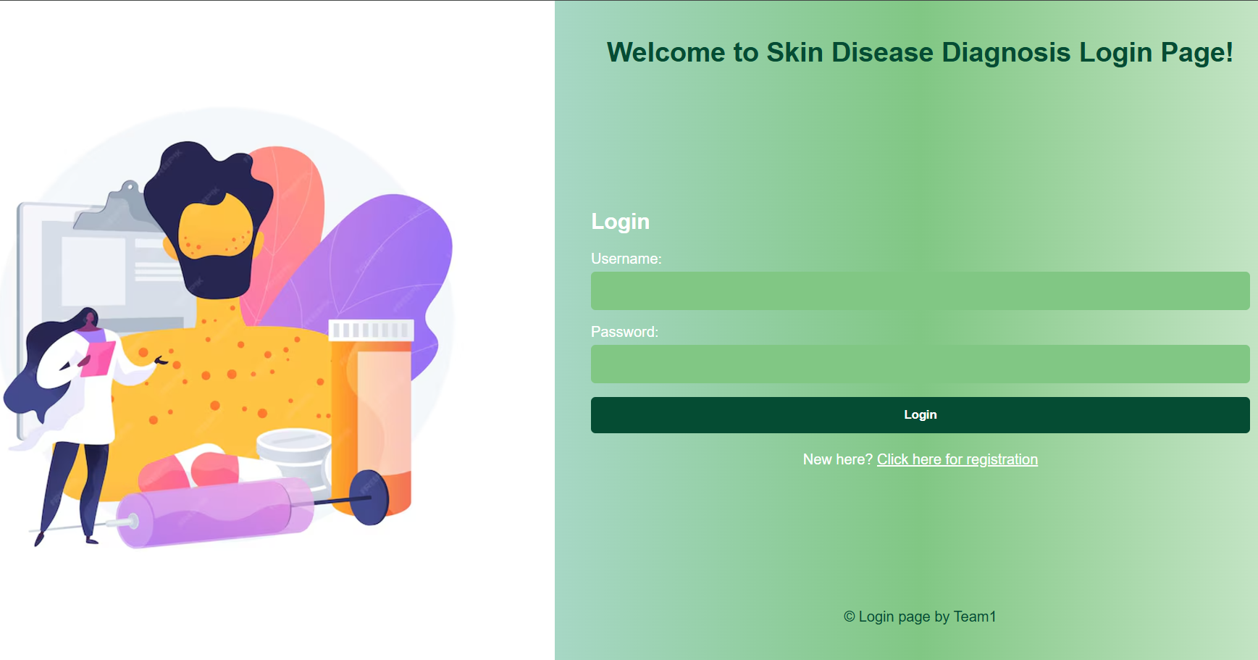
LOGIN PAGE:
User has to enter their existing Username and Password
If the username and password is correct then it redirects to the profile page, else “Invalid username and password” is displayed

Slide 11

REGISTRATION PAGE AND PROFILE PAGE SCREENSHOTS

Slide 12
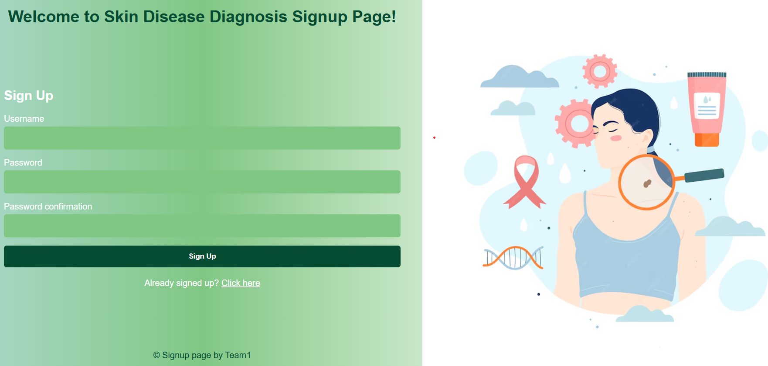
SIGNUP PAGE:
Enter a new Username which is not pre-existent
Enter unique Password
Confirm with same Password And the pass must be contain 8 characters
After information is filled and then signup button is clicked, if the password requirement is not fulfilled it displays the message “Password must be 8 characters”, else the user gets redirected to the login page
This link redirected to the login page if user already signed up

Slide 13
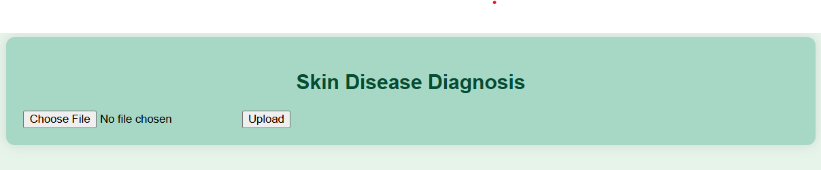
PROFILE PAGE:
A simple User Interface (UI) for a simple and seamless User Experience (UX)
Choose file to upload
Click upload button after the file is chosen

Slide 14
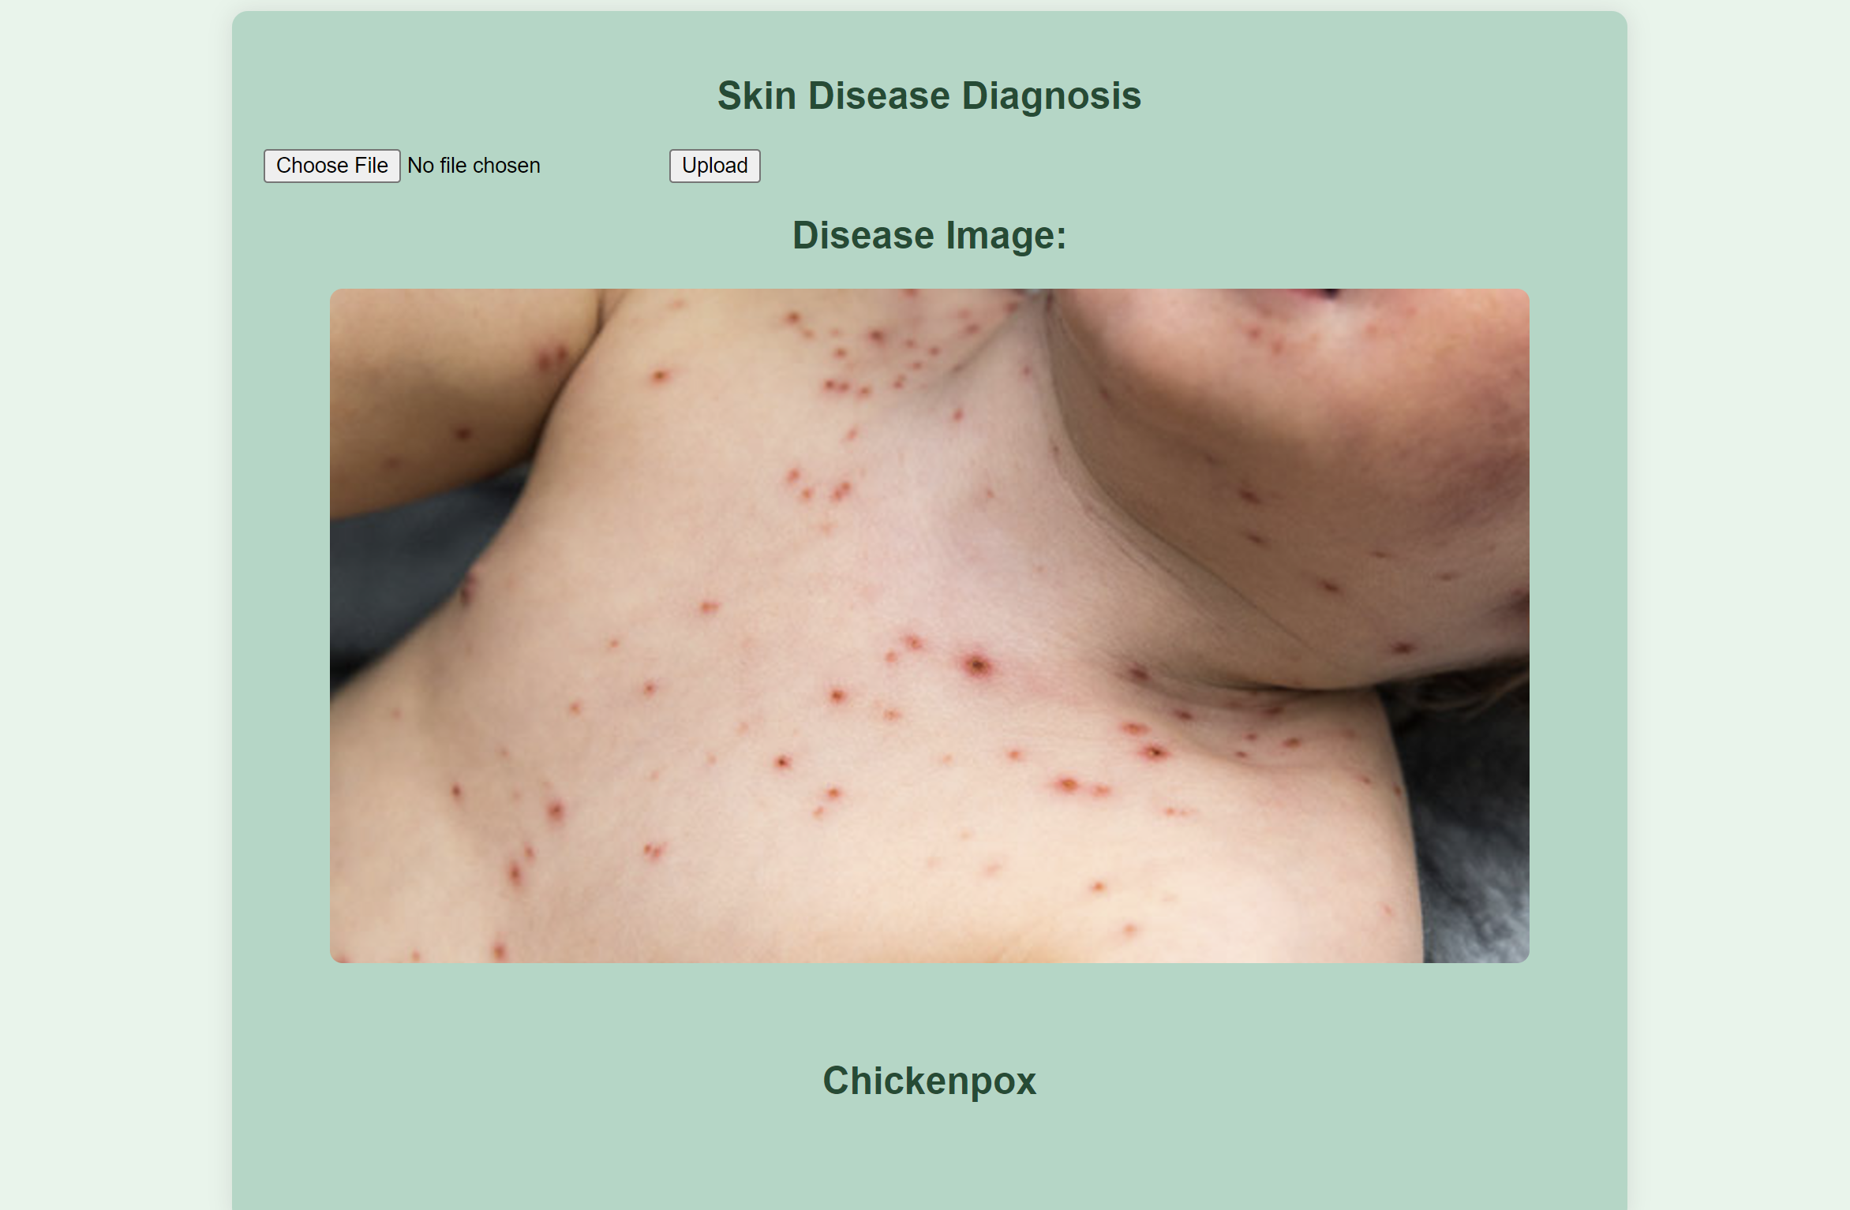
PROFILE PAGE AFTER UPLOD THE IMAGE:

Slide 15
MODEL TRAINING PROCESS
Data Preparation:
Images form various different categories (for eg. Cellulitis, Chickenpox, etc.) are resized to 64x64 pixels, flattened, normalized and standardized for feature extraction.
Model Training:
From the extracted features, many models like Support Vector Machine (SVM), Logistic Regression, K-Nearest Neighbor, Decision Tree, etc.
SMV (linear kernel) was chosen since it gave the best testing accuracy without overfitting.
1
2

Slide 16
MODEL TRAINING PROCESS
Evaluation:
Achieved 74% accuracy on test data set.
Integration:
The trained model was dumped into a “.joblib” file.
This model file is integrated into the Profile page, where images are processed and passed to the loaded model for prediction.
3
4

Slide 17
ABOUT MODEL
At first, we used the combination of Visual Transformers (ViT) from PyTorch and various models from Scikit-learn.
PyTorch has the option of using GPU (using CUDA toolkit) as a device, which allowed the model to be trained at an accelerated rate.
This produced a very good testing accuracy of 97.86%.
But, it turns out that the model was Overfitting and generating noisy and incorrect output.

Slide 18
ABOUT MODEL
So we deprecated the use of PyTorch, and proceeded with just Scikit-learn only.
Scikit-learn has various models like SVM (this too has various “kernels”), Logistic Regression, Decision Trees, Naïve Bayes, KNN, etc.
After trying and testing all these models (with different parameters and kernels), we selected SVM (linear kernel) since it gave us the best accuracy without either underfitting or overfitting.

Slide 19
CONCLUSION
The Advanced Skin Diseases System is an AI based image analyzer platform accessible from the web. It is a powerful tool that combines computer vision and machine learning to aid in identifying skin conditions with precision. By processing skin images to detect defects and providing accurate predictions, the system empowers users with valuable insights into their skin health.

Slide 20

CONCLUSION
This innovative solution bridges the gap between technology and healthcare, offering users a convenient and accurate way to address skin-related concerns.
This project provides an accessible web-technology based solution for diagnosis.

Slide 21


TEAM MEMBERS
Aditya Saklani
Ankita Pagare
Saurabh Kumar
Prabhakar Jha
Ankush Prajapati
Notes:
https://www.freepik.com/free-photo/medium-shot-doctors-work_23490790.htm

Slide 22
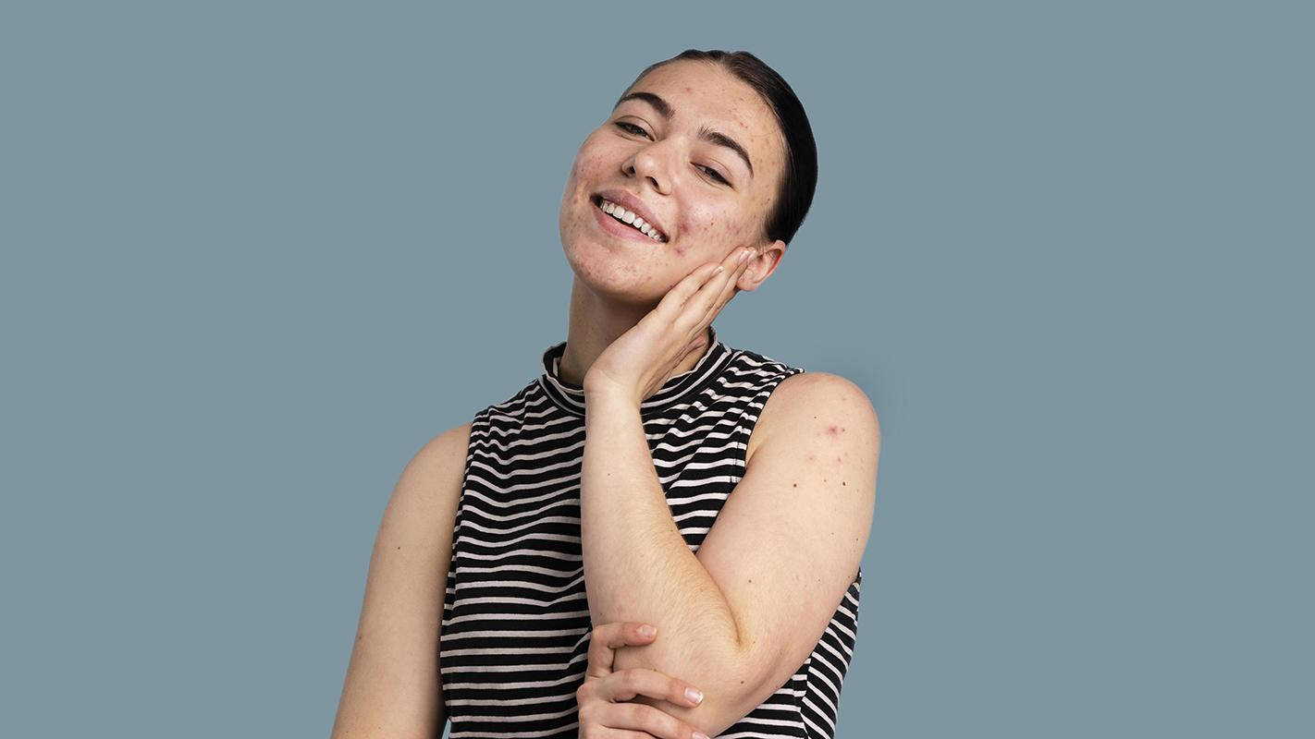
THANK YOU!

